Slide 1
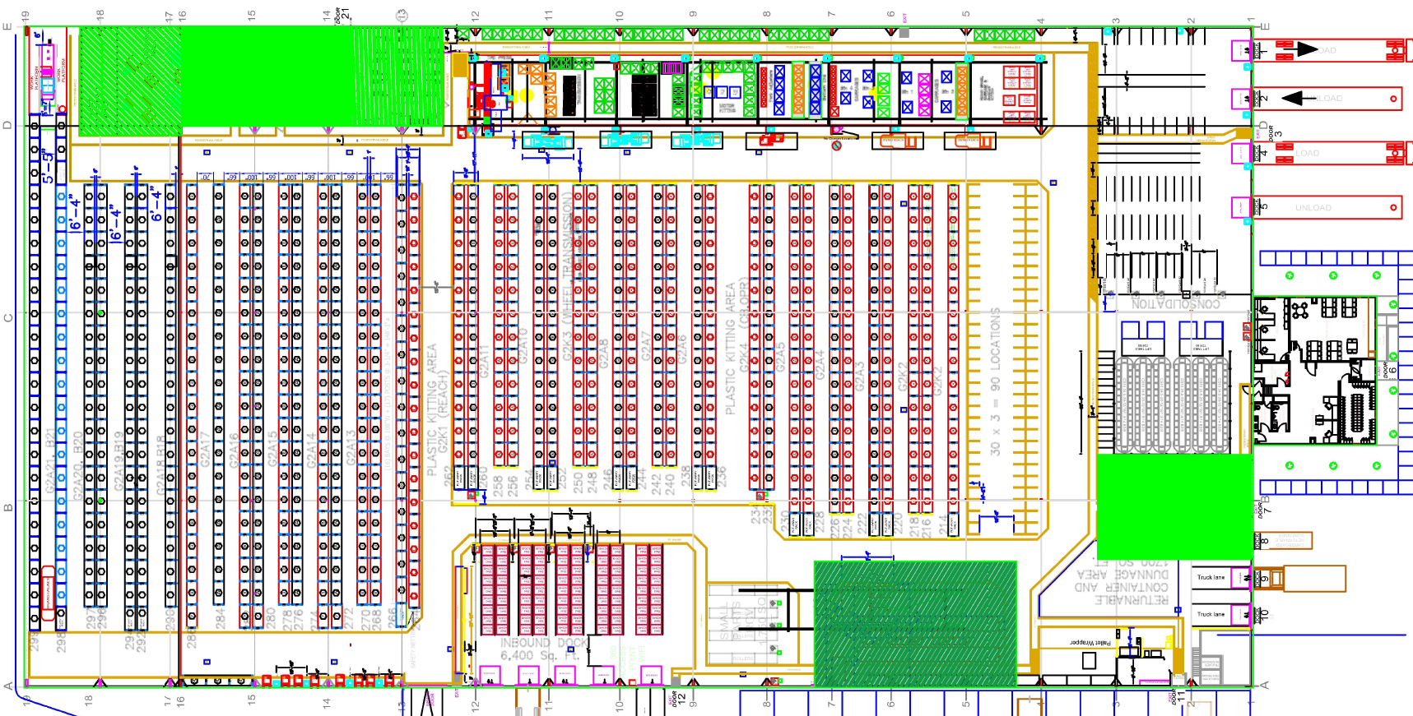
Valid Driving Area

Slide 2
→ One Way Aisle →
→ One Way Aisle →
→ One Way Aisle →
→ One Way Aisle →
→ One Way Aisle →
→ One Way Aisle →
→ One Way Aisle →
→ One Way Aisle →
→ One Way Aisle →
→ One Way Aisle →
→ One Way Aisle →
→ One Way Aisle →
→ One Way Aisle →
→ One Way Aisle →
→ One Way Aisle →

Slide 3
Pick and Drop (P&D) Stations

Slide 4
Slow Down Areas

